Slide 1
Introduction to data warehouses.
Data warehouse development lifecycle (Kimball’s approach).
By Dr. Gabriel

Slide 2
Key Definitions
Data mart is a specific, subject-oriented repository of data that was designed to answer specific questions
  Usually, multiple data marts exist to serve the needs of multiple business units (sales, marketing, operations, collections, accounting, etc.)
Data warehouse is a single organizational repository of enterprise wide data across many or all subject areas.
  Data warehouse is an enterprise wide collection of data marts

Slide 3
Key Definitions
“Business Intelligence” refers to reporting and analysis of data stored in the warehouse
Data warehouse is the foundation for business intelligence.
‘‘Data warehouse/business intelligence’’ (DW/BI) refers to the complete end-to-end system.

Slide 4
Two Main Data Warehouse Development Methodologies
Top-down approach
  The Inmon’s approach
  DW is developed based on the Enterprise wide data model
  DW as a single repository feeds data into data marts
  Longer to implement
    May fail due to the lack of patience and commitment
Bottom-up approach
  The Kimball’s approach
  Starts with one data mart (ex. sales); later on additional data marts are added (ex. collection, marketing, etc.)
  Data flows from source into data marts, then into the data warehouse
  Faster to implement
    Implementation in stages
  Need to ensure consistency of metadata
    Making sure each data mart calls Apple and Apple
The Hybrid approach

Slide 5
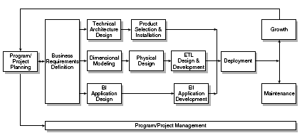
The Kimball Lifecycle Diagram

Slide 6
The Kimball Lifecycle
Illustrates the general flow of a DW implementation
Identifies task sequencing and highlights activities that should happen concurrently
May need to be customized to address the unique needs of your organization
Not every detail of every Lifecycle task will be performed on every project

Slide 7
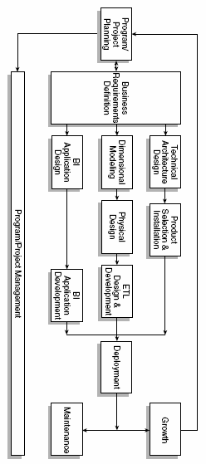
The Kimball Lifecycle,
SDLC, and DBLC
Planning
DB Initial Study
DB Design
Analysis
Implementation
Detailed System
Design
Testing
Implementation
Operation
Maintenance
Maintenance

Slide 8
Program/Project Planning
Kimball’s view of programs and projects
  Project refers to a single iteration of the Kimball Lifecycle
    from launch through deployment
  Program refers to the broader, ongoing coordination of resources, infrastructure, timelines, and communication across multiple projects
    a program contains multiple projects
  In real world, programs do not necessarily start before projects although ideally they should be.

Slide 9
Program/Project Planning
Project planning
  Scope definition ⬄understanding business requirements
  Tasks’ identification
  Scheduling
  Resource planning
  Workload assignment
  The end document represents a blueprint of the project

Slide 10
Program/Project Management
Enforces the project plan
Activities:
  Status monitoring
  Issue tracking
  Development of a comprehensive communication plan that addresses both the business and IT units

Slide 11
Business Requirements Definition
Success of the project depends on a solid understanding of the business requirements!!!
Understanding the key factors driving the business is crucial for successful translation of the business requirements into design considerations

Slide 12
What follows the business requirements definition?
3 concurrent tracks focusing on
  Technology
  Data
  Business intelligence applications
  Arrows in the diagram indicate the activity workflow along each of the parallel tracks
  Dependencies between the tasks are illustrated by the vertical alignment of the task boxes.

Slide 13
Technology Track
Technical Architecture Design
  Overall architectural framework and vision
  Considerations:
    the business requirements
    current technical environment
    planned strategic technical directions

Slide 14
Technology Track
Product Selection and Installation
  Based on the designed technical architecture
    Evaluation and selection of
      Products that will deliver needed capabilities
      Hardware platform
      Database management system
      Extract-transformation-load (ETL) tools
      Data access query tools
      Reporting tools must be evaluated
    Installation of selected products/components/tools
    Testing of installed products to ensure appropriate end-to-end integration within the data warehouse environment.

Slide 15
Data Track
Design of the dimensional model
The physical design of the model
Extraction, transformation, and loading (ETL) of source data into the target models.

Slide 16
Dimensional Modeling
Detailed data analysis of a single business process is performed to identify the fact table granularity, associated dimensions and attributes, and numeric facts.
Dimensional models contain the same data content and relationships as models normalized into third normal form, but structured differently.
  Improve understandability and query performance required by DW/BI
Primary constructs of a dimensional model
  fact tables
  dimension tables

Slide 17
Dimensional Modeling
Fact tables
  Contain the metrics resulting from a business process or measurement event, such as the sales ordering process or service call event
  Dimensional models should be structured around business processes and their associated data sources,
    This results in ability to design identical, consistent views of data for all observers, regardless of which business unit they belong to, which goes a long way toward eliminating misunderstandings at business meetings
  Fact table’s granularity should be set at the lowest, most atomic level captured by the business process
    This allows for maximum flexibility and extensibility.
      Business users will be able to ask constantly changing, free-ranging, and very precise questions.

Slide 18
Dimensional Modeling
Dimensional table
  Contain the descriptive attributes and characteristics associated with specific, tangible measurement events, such as the customer, product, or sales representative associated with an order being placed.
  Dimension attributes are used for constraining, grouping, or labeling in a query.
  Hierarchical many-to-one relationships are denormalized into single dimension tables.

Slide 19
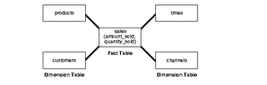
Star Schema
A fact table
Multiple dimension tables
Example: Assume this schema to be of a retail-chain. Fact will be revenue (money). How do you want to see data is called a dimension.

Slide 20
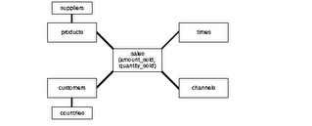
Snowflake Schema
The snowflake schema is a variation of the star schema used in a data warehouse.
The snowflake schema is a more complex schema than the star schema because the tables which describe the dimensions are normalized.

Slide 21
Snowflake Schema
Disadvantages:
  Fact tables are typically responsible for 90% or more of the storage requirements, so the benefit is normally insignificant.
  Normalization of the dimension tables ("snowflaking") can impair the performance of a data warehouse.
Advantages:
  If a dimension is very sparse (i.e. most of the possible values for the dimension have no data) and/or a dimension has a very long list of attributes which may be used in a query, the dimension table may occupy a significant proportion of the database and snowflaking may be appropriate.
In practice, many data warehouses will normalize some dimensions and not others, and hence use a combination of snowflake and classic star schema.

Slide 22
Physical Design
Defining the physical structures
  setting up the database environment
  Setting up appropriate security
  preliminary performance tuning strategies, from indexing to partitioning and aggregations.
  If appropriate, OLAP databases are also designed during this process.

Slide 23
ETL Design and Development
The MOST important stage
70% of the risk and effort in the DW project is attributed to this stage
ETL system capabilities:
  Extraction
  Cleansing and conforming
  Delivery and management

Slide 24
ETL
Raw data is extracted from the operational source systems and is being transformed into meaningful information for the business
ETL processes must be architected long before any data is extracted from the source
ETL system strives to deliver high throughput, as well as high quality output
Incoming data is checked for reasonable quality
Data quality conditions are continuously monitored
Kimball calls ETL a “data warehouse back room”

Slide 25
Business Intelligence
Application Track
Applications that query, analyze, and present information from the dimensional model.
BI applications deliver business value from the DW/BI solution, rather than just delivering the data
The goal is to deliver capabilities that are accepted by the business to support and enhance their decision making.
BI Application Design
  Identify the candidate BI applications and appropriate navigation interfaces to address the users’ needs and needed capabilities.
  Produce BI application specification
BI Application Development
  Configuration of the business metadata and tool infrastructure
  Construction and validation of the specified analytic and operational BI applications and the navigational portal

Slide 26
Deployment
It is crucial that adequate planning was performed to make sure that:
  the results of technology, data, and BI application tracks are tested and fit together properly
  Appropriate education and support infrastructure is in place.
It is critical that deployment be well orchestrated
Deployment should be deferred if all the pieces, such as training, documentation, and validated data, are not ready for production release.

Slide 27
Maintenance
Occurs when the system is in production
Includes:
  technical operational tasks that are necessary to keep the system performing optimally
    usage monitoring
    performance tuning
    index maintenance
    system backup
  Ongoing support, education, and communication with business users

Slide 28
Growth
DW systems tend to expand (if they were successful)
  Is considered as a sign of success
  New requests need to be prioritized
  Starting the cycle again
    Building upon the foundation that has already been established
    Focusing on the new requirements

Slide 29
Questions ?

